Slide 1

Quantitative Analysis of the Structural Health of Railway Turnout Using Acoustic Emission Technique
M. Kongpuang1*, R. Culwick1, N. Cheputeh1, A. Marsh1, V. L. Jantara Junior1,
P. Vallely1, 2, S. Kaewunruen3, M. Papaelias1
¹School of Metallurgy and Materials, The University of Birmingham, Birmingham,
B15 2TT, UK
²Network Rail, Baskerville House, Birmingham, B1 2ND, UK
³School of Engineering, The University of Birmingham, Birmingham, B15 2TT, UK
NDT and Condition Monitoring Group ,School of Metallurgy and Materials

Slide 2
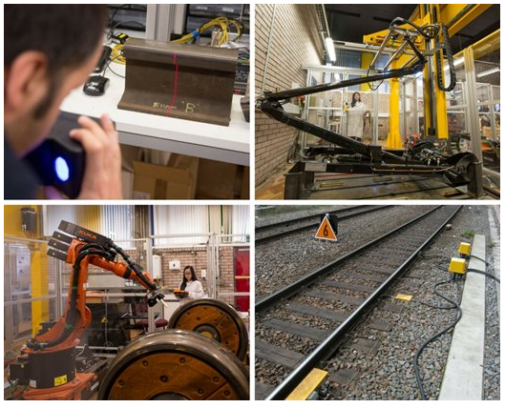
Rail Inspection
Conventional NDT
Visual Inspection (VI)
Ultrasonic Testing (UT)
Eddy Current Testing (ET)
Magnetic Particle Inspection (MPI)
Radio Graphic Testing (RT)
Electromagnetic Acoustic Transducer (EMAT)
etc.
Advanced NDT
Acoustic Emission Technique
Ultrasonic Phased Arrays
Long Range Ultrasonic
etc.
Birmingham Centre for Railway Research and Education
(https://www.birmingham.ac.uk/research/railway/research/condition-monitoring-and-ndt.aspx)

Slide 3
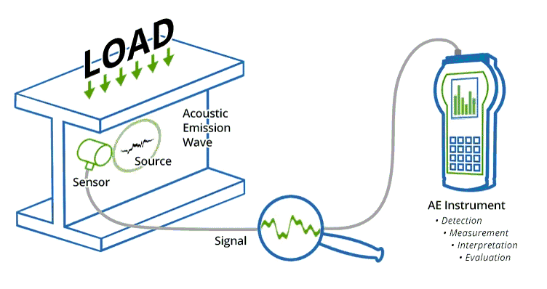
Acoustic Emission Technique
Advantage
Real time monitoring in service structure
High sensitivity
Early and rapid detection of defects, flaws, cracks etc.
Cost reduction/Time reduction
Minimization of plant downtime for inspection, no need for scanning the whole structural surface
Limitation
  AE alone allows only for location of defect, but not size and shape
  Sensitivity to environmental noise and mechanical noise is a major disadvantage of this method.
https://mistrasgroup.co.uk/products-and-systems/ae-systems/

Slide 4
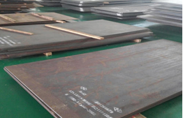
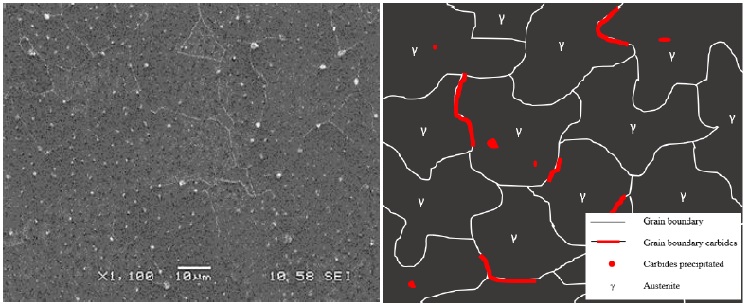
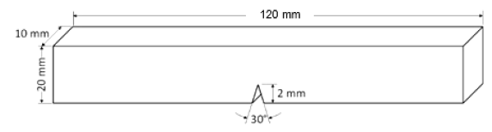
MATERIAL AND SPECIMEN
Typical chemical composition Austenitic cast manganese steel (in wt %).
SEM micrographs of the metallographic samples and schematic of austenitic microstructure showing austenite phase, grain boundary, and carbide precipitation in the grain.
Single edge-notch specimen extraction in a three-point bending test.

Slide 5
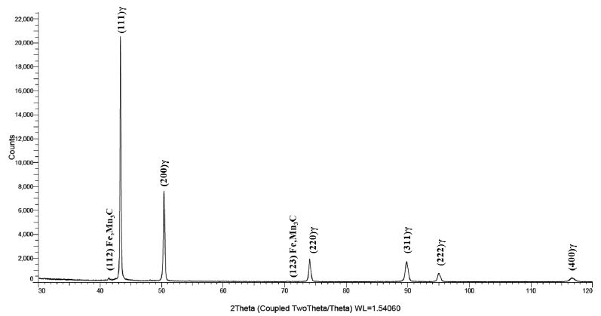
MATERIAL
primary carbide formed
X-ray diffraction patterns of tested of austenitic cast manganese steel.

Slide 6
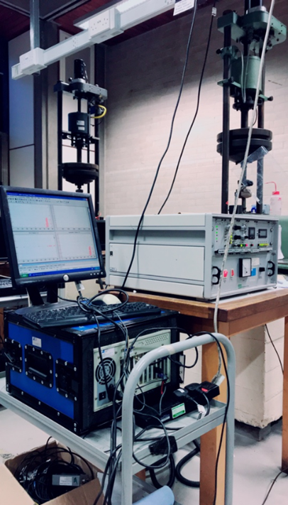
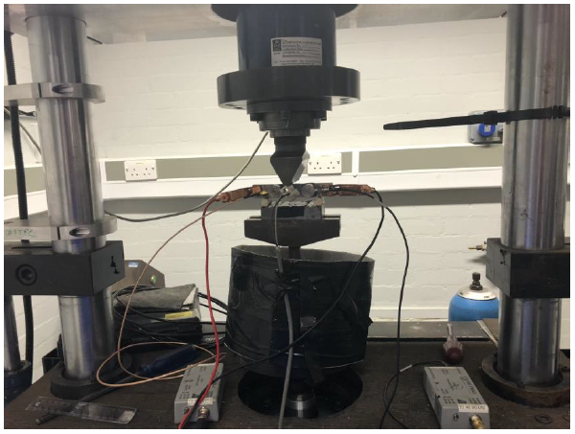
PRE-CRACKING
Experimental
FATIGUE TESTING

Slide 7
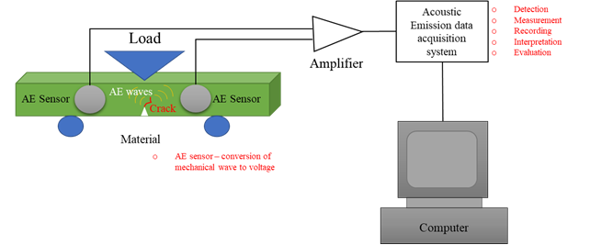
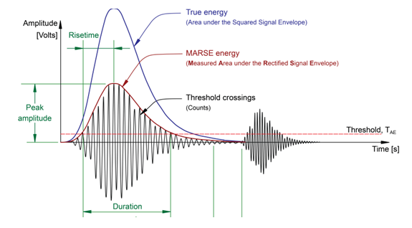
Experimental Set-up
AE Parameters

Slide 8
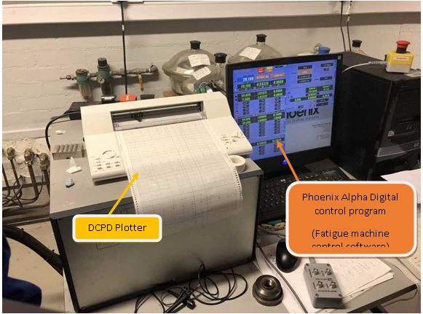
DCPD
Paris’ Law
The relationship of is the range of the stress intensity factor during the fatigue cycle (ΔK) to the crack growth rate (da/dN) between the rates of expansion of the cracks from low to high can be explained by the Paris’s - Erdogan law
Where a is the crack length and da/dN is the crack growth rate, C and m are constants that particular on the material, environment and stress ratio, and ΔK is the range of the stress intensity factor during the fatigue cycle
The crack length (a) can be calculated using Johnson’s formula
For a specific geometry, KI coefficients are defined. The stress intensity factor (KI) at the crack tip of a three point bending sample is (Standard, 2008)
From Johnson’s formula, a can be obtained by solving
Where P is the applied load, B is the thickness of the specimen, a is the crack length, and W is the width of the specimen.

Slide 9
RESULT

Slide 10
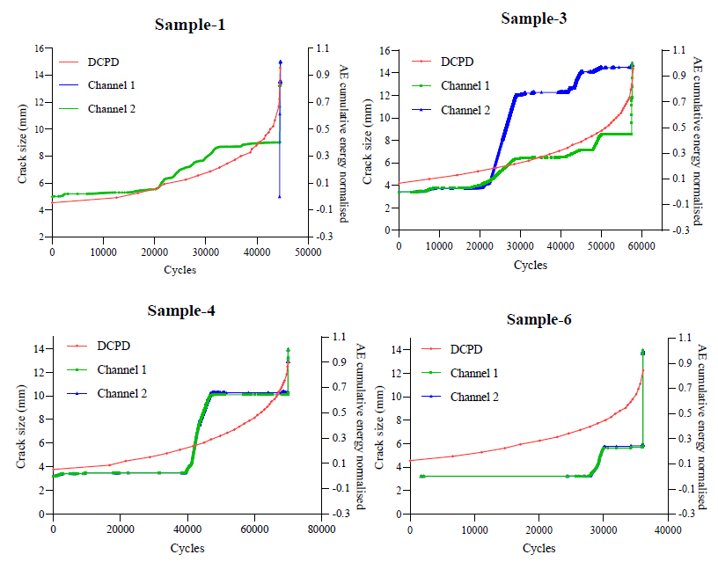
AE signal analysis
cumulative AE energy plot from R50α Sensors compares to the crack
size measured using the DCPD instrument of austenitic cast manganese steel
samples 1, 3, 4, and 6.

Slide 11
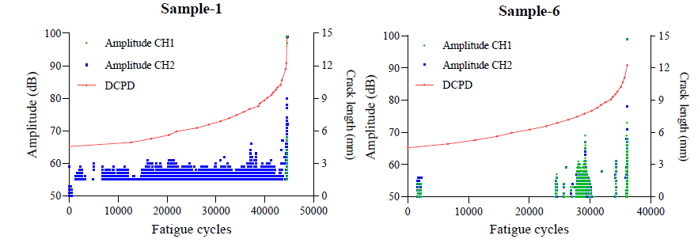
AE signal analysis
Amplitude against fatigue cycles for austenitic cast manganese steel
sample 1 (continuous crack activity) and sample 6 (short peaks in early – ending
with a high peak at failure).

Slide 12
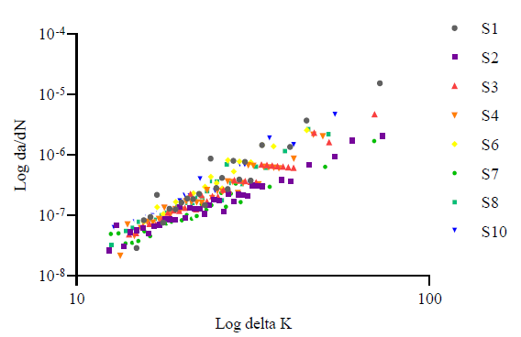
Fatigue crack growth rates
The Paris law for fatigue crack growth rates of austenitic cast manganese
steel (Stage II in Micro-mechanism of Fatigue).
Notes:
According to the test standard ASTM E647, 1990 [17], the experiment was conducted using cyclic load under constant amplitude loading. The relationship between crack size (a) and cycle (N) is the primary data collected from the experiment. Then use the data obtained to calculate and plot the relationship between fatigue crack growth rates (da/dN) and crack-tip stress-intensity factor range (ΔK).
After the plotted plot log da/dN as a function of log ΔK, the slope of the plot would give the m, and the Y-intercept will provide the value of C. The average C and m values from the experiment in austenitic cast manganese steels are C = 4.08 x10-11, and m = 2.604 with R= 0.972, and R2 = 0.945.

Slide 13

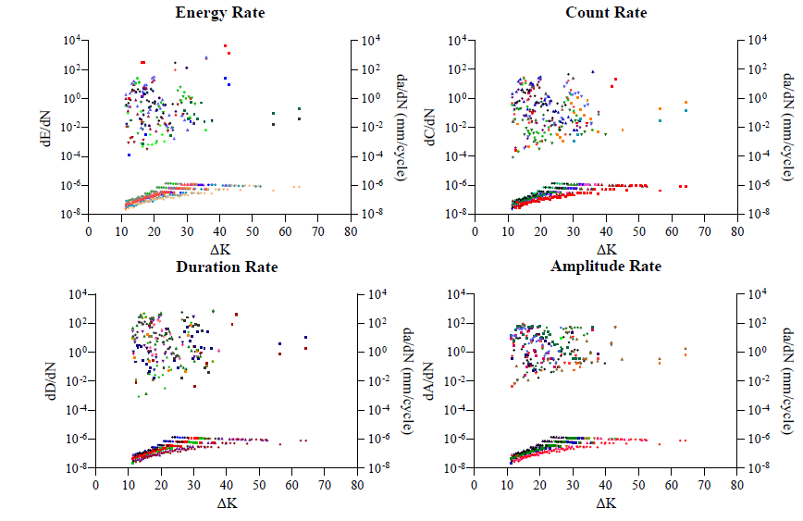
AE and crack growth parameters
The crack growth rate and the energy rate were calculated in the same way. As a result, the energy rate and ΔK relationship can be defined as follows (and similarly for dA/dN).
The crack growth rate parameters with ΔK for all austenitic cast
manganese steel samples in logarithmic scale.

Slide 14
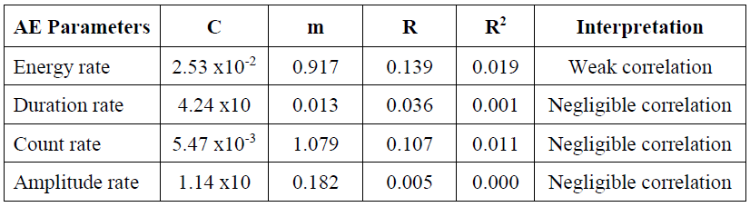
Pearson Correlation (R) and Linear Regression Analysis (R²)
Average fit parameters against ΔK

Slide 15
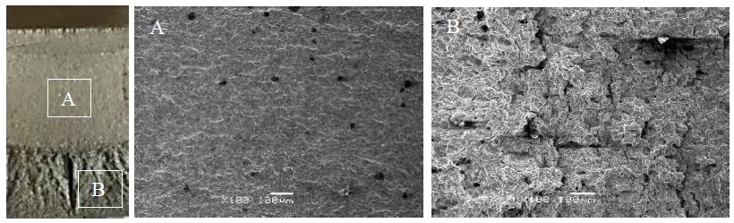
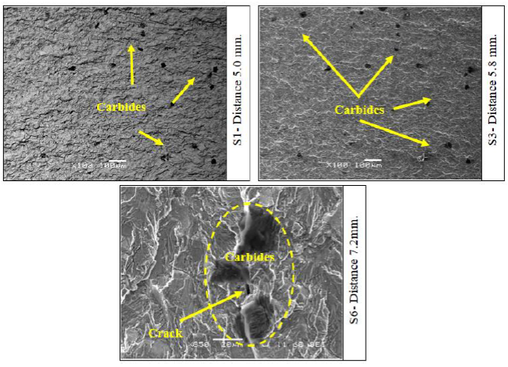
Fracture Surface Analysis
Macroscopic view of the fractured surface showing the morphologies of
the fatigue crack growth area (A) and fast fracture area (B).
SEM Micrographs show the fracture surface (top left) scatter of
carbides of sample 1 at a distance of 5.0 mm. (top right) scatter of carbides of
sample 3 at approximately 5.8 mm crack length, and (bottom) carbides and crack
under carbides of sample 6 at approximately 7.2 mm crack length.

Slide 16
Conclusion and Future work
Three-point bending fatigue tests were carried out on cast manganese steel samples. Crack growth was monitored using a commercial AE system procured from PAC.
It was impossible to observe a clear Paris trend from the recorded AE activity. Based on hardness measurements and the SEM fractographic analysis this is likely to be due to the plasticity occurring at the tip of the fatigue crack in the tested samples.
This is possible because the austenitic cast manganese steel samples were cut from a plate that had not been work-hardened previously and an additional contributing factor is the effect of carbides in the microstructure before fatigue testing.
Further studies should be performed on cast manganese steel samples that have been work-hardened and then be carried out using the AE monitoring techniques used in this study on the live network.

Slide 17
Acknowledgements
The financial support from the Thai government and EPSRC with respect to this work is gratefully acknowledged.
Notes:
สุดท้ายก็ต้องขอขอบคุณหน่วยงานเหล่านี้ที่มีส่วนสนับสนุนงานวิจัยให้ดำเนินงานได้ด้วยดีค่ะ

Slide 18
References
1. Dastur YN, Leslie WC. Mechanism of work hardening in Hadfield manganese steel. Metallurgical Transactions A. 1981;12(5):749-759.
2. Bayraktar E, Khalid FA, Levaillant C. Deformation and fracture behaviour of high manganese austenitic steel. Journal of Materials Processing Technology. 2004;147(2):145-154.
3. Liu, C., Bassim, M. and Lawrence, S. S. (1993) 'Evaluation of fatigue-crack initiation at inclusions in fully pearlitic steels', Materials Science and Engineering: A, 167(1-2), pp. 107-113.
4. Ph Papaelias, M., Roberts, C. and Davis, C. (2008) 'A review on non-destructive evaluation of rails: state-of-the-art and future development', Proceedings of the Institution of Mechanical Engineers, Part F: Journal of Rail and rapid transit, 222(4), pp. 367-384.
5. Marfo, A., Luo, Y. and Zhong-an, C. (2013) 'Quantitative acoustic emission fatigue crack characterisation in structural steel and weld’, Advances in Civil Engineering, 2013.
6. Yoneda, K. and Ye, J. (2006) 'Crack propagation and acoustic emission behavior of silver-added Dy123 bulk superconductor', Physica C: Superconductivity and its applications, 445, pp. 371-374.
7. Shi, S., Han, Z., Liu, Z., Vallely, P., Soua, S., Kaewunruen, S. and Papaelias, M. (2018) 'Quantitative monitoring of brittle fatigue crack growth in railway steel using acoustic emission', Proceedings of the Institution of Mechanical Engineers, Part F: Journal of Rail and Rapid Transit, 232(4), pp. 1211-1224.
8. Schindelin, J., Arganda-Carreras, I., Frise, E., Kaynig, V., Longair, M., Pietzsch, T., Preibisch, S., Rueden, C., Saalfeld, S. and Schmid, B. (2012) 'Fiji: an opensource platform for biological-image analysis', Nature methods, 9(7), pp. 676.
9. Johnson, H. J. M. R. and Standards (1965) 'Calibrating the electric potential method for studying slow crack growth', 5(1), pp. 442-445.
10. Paris, P. and Erdogan, F. J. J. o. b. e. (1963) 'A critical analysis of crack propagation laws', 85(4), pp. 528-533.
11. ASTM, E. (2007) 'Standard Test Methods for Notched Bar Impact Testing of Metallic Materials'
12. Wang, W.-F. and Wu, M.-J. (2006) 'Effect of silicon content and aging time on density, hardness, toughness and corrosion resistance of sintered 303LSC–Si stainless steels', Materials Science and Engineering: A, 425(1-2), pp. 167-171.
13. Máthis, K. and Chmelík, F. (2012) 'Exploring plastic deformation of metallic materials by the acoustic emission technique', Acoustic Emission, pp. 23-48.
14. Mindrila, D. and Balentyne, P. (2017) 'Scatterplots and correlation', Retrieved from. Montgomery, D. C., Peck, E. A. and Vining, G. G. (2021) Introduction to linear regression analysis. John Wiley & Sons.
15. Schober, P., Boer, C. and Schwarte, L. A. (2018) 'Correlation coefficients: appropriate use and interpretation', Anesthesia & Analgesia, 126(5), pp. 1763-1768. Page 13 of 1413
16. Aggelis, D., Kordatos, E. and Matikas, T. (2011) 'Acoustic emission for fatigue damage characterisation in metal plates', Mechanics Research Communications, 38(2), pp. 106-110.
17. ASTM, E. (2011) '647: Standard test method for measurement of fatigue crack growth rates', Annual book of ASTM standards, 3, pp. 591-630.

